Slide 1
ZSE Results Section Basic Outline

Slide 2
0. Basic ideas to convey

Slide 3
1. Zeolite frameworks described by rings differ depending on the convention used to find rings
Considering all rings (cycles that do not contain shortcuts), the distribution of frameworks containing each size rings is different than what is commonly referred to on the IZA

Slide 4
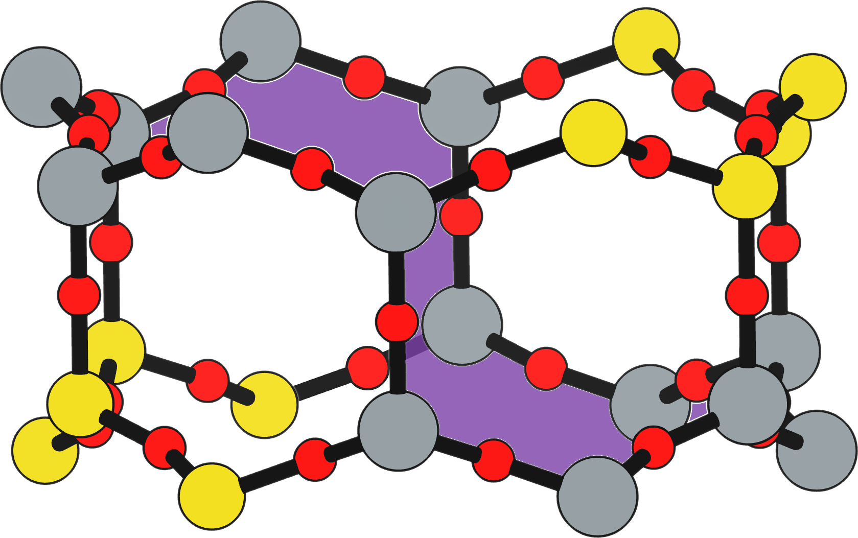
2. Specific types of rings show up that we may not want to count (cycles traversing stacked rings)
Two even number stacked rings (12-MRs here), leads to a third ring that traverses half of each stacked ring (14-MR in purple)
Sometimes we don’t want to count these, and have developed a new algorithm to remove them

Slide 5
6. Using each ring finding convention we also see differences in rings present across the IZA list of frameworks
We can find all ring sizes present in a framework by taking a union of the T-site rings for each distinct T-site in that framework
Frequency plot shows how each ring finding convention differs

Slide 6
8. Connectivity rules for ring counting sometimes leave out voids that behave like rings
Cutout of the MFI framework showing two 5-membered rings and one 6-membered cycle
The connectivity rules described here would return only the two
5-membered rings
We denote this
6-membered cycle as a geometric ring
This 6-membered cycle does not obey the connectivity rules of classic ring definitions due to the ”shortcut’
These geometric rings can still prove to be important in terms of catalysis and ion exchange
Previous studies have suggested that an Al pair in this 6-membered cycle participates in for Co²⁺ uptake
Notes:
Maybe move right after slide 5

Slide 7
3. T-sites can be described by counting the rings that pass through them
This description of T-sites will also depend on the ring counting convention used
Here each convention leads to a different ring count for T1 in AFI

Slide 8
3.1. Comparing each ring finding convention for single T-site zeolite frameworks to highlight differences
This table highlights the differences in rings found for a set of single T-site frameworks
We use the ring index to display counts (Ring Size_{Count}) [1]
In general, rings provide the least restrictive counts, and vertex symbols provide the most restrictive counts
Framework | Rings | This Work | Shortest Path [1] | Vertex Symbol [2]
ABW | 4₂ •6₃ •8₄ | 4₂ •6₃ •8₄ | 4₂ •6₃ •8₄ | 4₂ •6₃ •8₂
AFI | 4₁ •6₁₃ •12₁ •14₇ | 4₁ •6₁₃ •12₁ | 4₁ •6₁₃ | 4₁ •6₁₁
CHA | 4₃ •6₁ •8₆ •12₁ | 4₃ •6₁ •8₂ •12₁ | 4₃ •6₁ •8₂ | 4₃ •6₁ •8₂
DFT | 4₂ •6₆ •8₁₀ •10₁₀ | 4₂ •6₆ •8₁₀ | 4₂ •6₆ •8₁₀ | 4₂ •6₄ •8₆
GME | 4₃ •6₁ •8₆ •12₇ | 4₃ •6₁ •8₂ •12₁ | 4₃ •6₁ •8₂ | 4₃ •6₁ •8₂
MER | 4₃ •8₄ •10₁₀ •14₁₄ | 4₃ •8₄ | 4₃ •8₄ | 4₃ •8₄
MON | 4₁ •5₅ •8₆ | 4₁ •5₅ •8₆ | 4₁ •5₅ •8₆ | 4₁ •5₄ •8₄
NPO | 3₁ •6₆ •12₄₀ | 3₁ •6₆ •12₄₀ | 3₁ •6₆ | 3₁ •6₆
[1] G. Sastre and J. Gale, Microporous and Mesoporous Materials, 43 (2011) 27-40
[2] Baerlocher, C. and McCusker, L. Database of Zeolite Structures. URL http://www. iza-structure.org/databases/

Slide 9
3.2 TON 4 T-Site Example

Slide 10
4. Comparison of every T-site from every framework in the IZA shows that each convention differs in rings found
The cumulative distribution functions of T-sites containing each size ring shows that results follow the funnel diagram for ring counting conventions
Vertex symbol and shortest path rings often leave out larger rings that may still be of interest
Differences start to arise at rings >= 6-MR
Notes:
Inset to highlight the differences

Slide 11
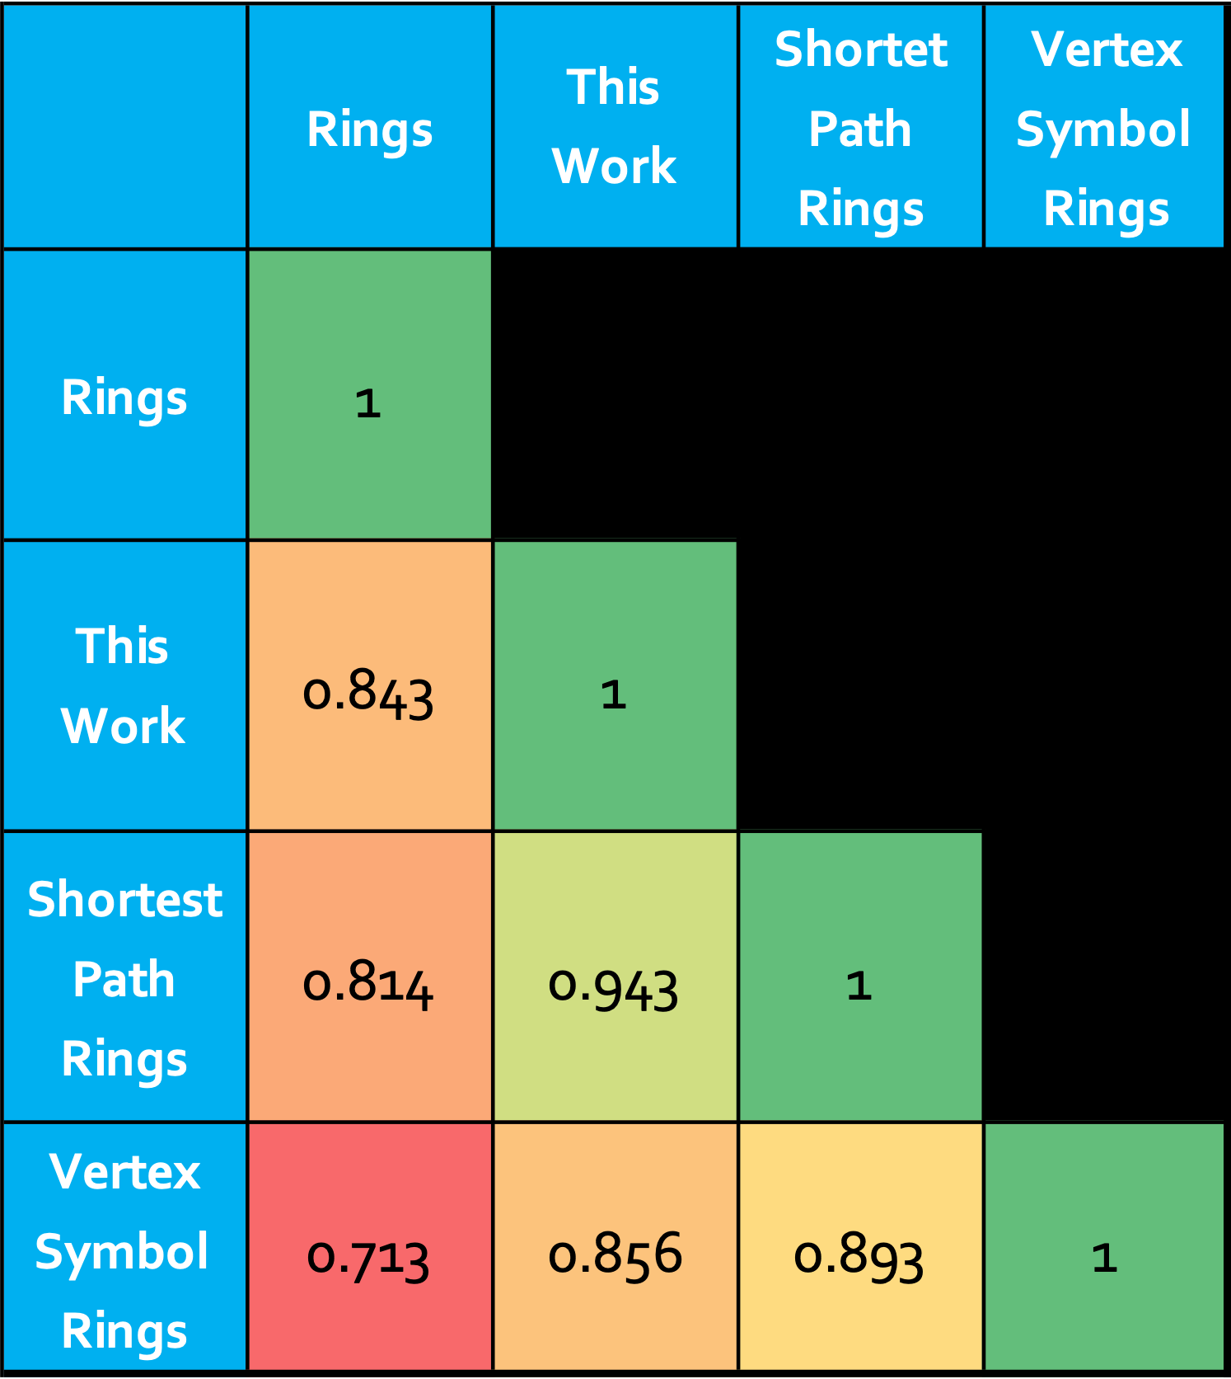
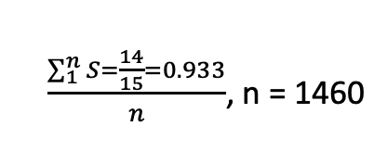
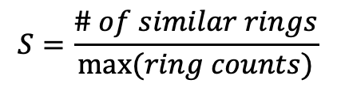
5. We can compare how similar the rings counted by each method are for every T-site
This Work
Shortest Path Rings
6-MR
6-MR
12-MR
x13
x13
x1
4-MR x1
4-MR x1
$$S=\frac{\# of similar rings}{max⁡(ring counts)}$$
$\frac{\sum_{1}^{n}{S=\frac{14}{15}=0.933}}{n}$, n = 1460
Notes:
Plot the distribution of similarity scores

Slide 12
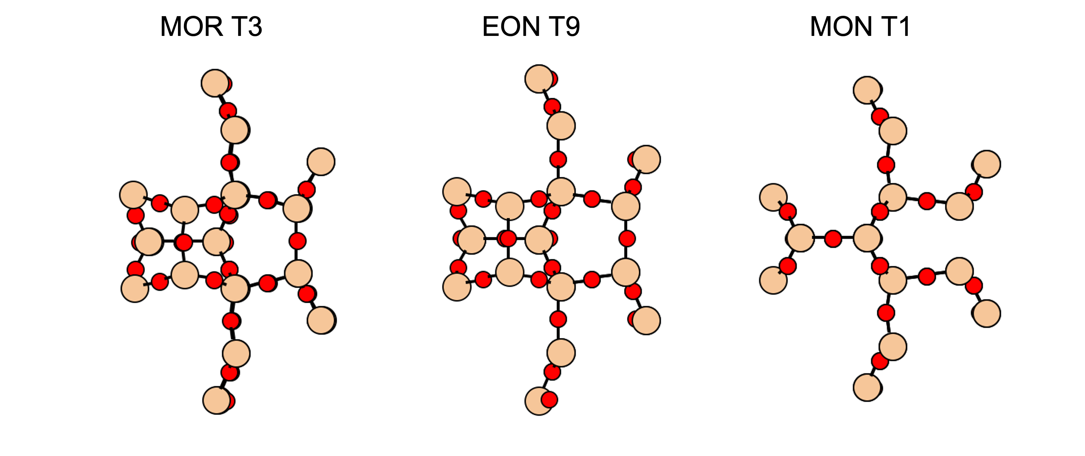
7. The commonly used vertex symbol does not account for stereochemistry of rings around a T-site
Vertex Symbol: 4•5₂•5•8₂•5•8₂
T-sites with the same vertex symbol (as shown below) do not always have the same structural orientation of rings
These subtle but distinct differences have been accounted for with a new algorithm for listing the vertex symbol ring sizes: ordered vertex symbol
Ordered Vertex Symbol:
MOR: 8₂•8₂•5₂•5•4•5
EON: 8₂•8₂•5₂•5•4•5
MON: 8₂•8₂•4•5•5₂•5
Notes:
Another example vertex symbol

